Slide 1
Extend Microsoft Teams
Microsoft Teams Apps.
Webhooks in Microsoft Teams.
Tabs in Microsoft Teams.
Messaging extensions in Microsoft Teams.
Conversational bots in Microsoft Teams.

Slide 2
Microsoft Teams apps

Slide 3
Components of a Microsoft Teams app
A Microsoft Teams app consists of three primary components:
The Microsoft Teams client (web, desktop, or mobile) provides the extensions points and UI elements users will interact with.
Teams app package creates the app installed by users.
Manifest file
Icons
Web services hosted by developers provide the APIs and logic that power the app.
Notes:
Microsoft Teams is the team collaboration hub in Office 365
A Teams app extends the Teams client (web, mobile, and desktop) with web services developers host.
A Teams app manifest is a text file that contains the metadata required to present an app to users. Manifests define the user experience.
Note that the Microsoft Teams Platform is not a hosting service; the web services powering your app must be hosted by you and accessible by HTTPS over the internet.
It is also important to keep in mind that any functionality you expose in a Microsoft Teams app is publicly available over the internet unless you take additional steps to secure it. If you are providing access to confidential or protected information you'll want make sure your services are at a minimum authenticating the endpoint connecting to your app, or authenticating your users.

Slide 4
Microsoft Teams platform UX elements
The Microsoft Teams Platform provides flexible UI elements for apps to take advantage of.
Microsoft Teams platform elements:
Cards and card actions.
Task modules.
Deep links.
Web content pages.
Notes:
Teams UI/UX elements allow you to create rich experiences that feel native to the Teams client.
A card is a UI container for short or related pieces of information. Card can include buttons that trigger card actions.
Task modules can simplify the user experience for workflows that require data input. Gather input in a Teams-aware popup.
Deep links: You can create deep links to entities in Teams. Typically, this is used to create links that navigate to content and information within your tab.
A webpage you host can be embedded in a tab or a task module as a web content page.

Slide 5
Extensible points in the Teams client
There are multiple places where the Microsoft Teams client can be extended to allow users to interact with the app.
Options for extending the Teams client:
Teams, channels and group chats
Personal apps
Messages
Notes:
Depending on your scenario you may choose to focus on a single extension point or combine multiple.
Teams, channels and group chats can be extended with conversational bots, configurable tabs, webhooks and connectors.
Personal apps can be extended with conversational bots and personal tabs
Messaging extensions allow users to interact with your web service through buttons and forms from the compose message area, the command box, or directly from a message. Your app can respond by presenting a form to the user to collect more information, sending a reply to the original message, or sending a message directly to the user.

Slide 6
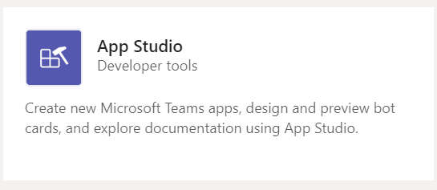
App Studio for Microsoft Teams app development
App Studio streamlines the process of creating manifests and packages for Teams apps.
Use App Studio to:
Create and edit app manifests
Design and preview cards
Find documentation
Access UI controls in the React control library
Notes:
You can find and install App Studio in the Teams store.
The React control library will be deprecated in the future. Consider using the Fluent-UI react controls as an alternative (formerly Stardust UI).

Slide 7
Options for distributing a Teams app
Three options for distributing a Microsoft Teams app.
Share app package directly.
Publish app to organizational app catalog.
Publish app to public App Store.
All app installations in Microsoft Teams are context-specific
Notes:
Sharing the app package directly is useful when the app is directed towards a limited audience.
If the app is applicable to a specific organization, a tenant administrator can upload the app to the organization’s app catalog.
If the app is intended for all Teams users, the app can be submitted for publication in the public app store. This involves a review process.
Because all app installations in Teams are context-specific, the entirety of an app may not always be installed for all users.

Slide 8
Demo
Understanding the components of a Microsoft Teams App
Notes:
Demo Resources Found Here: https://microsoft.sharepoint.com/:w:/t/MOCtoBaselineevents/ERFDociiWvdAul1JL-70NPYB17RNkC-tZv6W_EWtpTSa9Q?e=p2gMgT

Slide 9
Webhooks in Microsoft Teams

Slide 10
Webhooks and Connectors in Microsoft Teams
Outgoing and incoming webhooks both allow developers to connect web services to channels and teams inside Microsoft Teams.
Outgoing webhooks allow users to send text messages from a channel to the developer’s web services without having to use the Microsoft Bot Framework.
Incoming webhooks work as a type of connector, allowing users to subscribe to receive notifications and messages from a developer’s web services.
Notes:
Webhooks allow you to connect your web services to the channels and teams inside Microsoft Teams.

Slide 11
Outgoing webhooks in Microsoft Teams
Outgoing webhooks post data from Teams to any chosen service capable of accepting a JSON payload. Once an outgoing webhook is added to a team, it acts like bot, listening in channels for messages using @mention, sending notifications to external web services, and responding with rich messages that can include cards and images.
Key features:
Scoped Configuration.
Reactive Messaging.
Standard HTTP messaging exchange.
Teams API support method.
Limitations.

Slide 12
Incoming webhooks in Microsoft Teams
Incoming webhooks function as connectors, providing a simple way for an external app to share content in team channels. They are useful for tracking and notification.
Teams provides a unique URL to which you send a JSON payload with the message that you want to POST, typically in a card format.
Key features:
Scoped configuration.
Secure resource definitions.
Actionable messaging support.
Independent HTTPS messaging support.
Markdown support.

Slide 13
Demo
Working with webhooks in Microsoft Teams
Notes:
Demo Resources Found Here: https://microsoft.sharepoint.com/:w:/t/MOCtoBaselineevents/Eb8M3kJioo5Fh3S0ON6Co20BOrpUwOCderLEhj4uOm1azA?e=R2ca0d

Slide 14
Tabs in Microsoft Teams

Slide 15
What is a tab in Teams?
In Microsoft Teams, tabs display rich interactive web content. Developers Can create two types of tabs—static and configurable.
Static tabs provide content for individual users.
Configurable tabs provide a single type of content for an entire team.
Tab scope:
Teams (team scope)
Group chat (groupchat scope)
Personal (personal scope)
Differences between tabs and a browser.
Notes:
Tabs are pages that display interactive content.

Slide 16
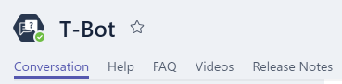
Static tabs
A static tab is a content page that is declared directly in your manifest and—unlike a configurable tab—does not require a configuration page.
Create tab content.
Static tabs on mobile clients.

Slide 17
Configurable tabs
A configurable tab becomes part of a channel and provides on type of information to a team.
Configurable tab scope.
Creating a configurable tab involves the following:
Create the configuration page: For configurable tabs, you must provide a configuration page to present options and gather information so users can customize the content in, and experience with, your tab. You can also enable users to update or remove a tab after they add it.
Create the content page: A content page is an HTML page that you host. You can also provide a page for users to specify what happens to content when they remove a tab.

Slide 18
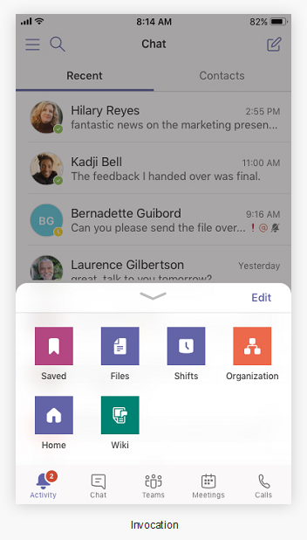
Tabs on mobile
Group and channel tabs are available on mobile clients.
Developer considerations for mobile support:
Testing on mobile clients.
Responsive design.
Authentication.
Low bandwidth and intermittent connections.
Design considerations for mobile.
Tabs with bots on mobile.
UI components.
Notes:
Your contentUrl will be loaded in the mobile Teams client.
For channel/group tabs, users can still open your tab in a separate browser via your websiteUrl, however your contentUrl will be loaded first.
If your tab uses authentication, you must upgrade your Teams JavaScript SDK to version 1.4.1 or later, or authentication will fail.
Custom tabs can be part of a channel, group chat, or personal app (apps that contain static tabs and/or a one-to-one bot).
Personal apps are available on mobile clients in the App Drawer. The app can only be installed from a desktop or web client, and can take up to 24 hours to appear on mobile clients.
Group and channel tabs are available on mobile clients as well. Uses your websiteUrl to launch your tab in a browser window. However, they can be loaded on a mobile client by clicking the ... overflow menu next to the tab and choosing Open, which will use your contentUrl to load the tab inside the Teams mobile client.

Slide 19
Demo
Creating tabs in Microsoft Teams
Notes:
Demo Resources Found Here: https://microsoft.sharepoint.com/:w:/t/MOCtoBaselineevents/EdLjY3x6rdJAowOLVrPYkgEB7_cUK7V8Gf3csBwa1DMXxQ?e=bIemI1

Slide 20
Messaging extensions in Microsoft Teams

Slide 21
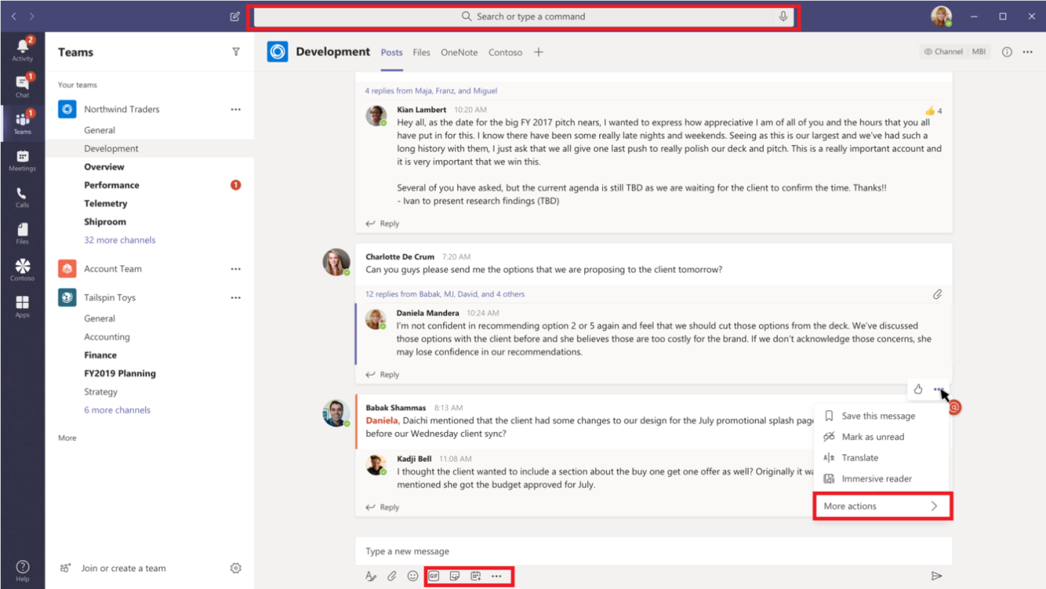
What are messaging extensions for Teams?
Messaging extensions allow users to query your service for information, and post information to your service.
Users can search, or initiate actions, in an external system from the compose message area, the command box, or directly from a message.
Developers can then send the results of that interaction back to the Microsoft Teams client, typically in the form of a richly formatted card.
Search command invoke locations.
Action command invoke locations.
Notes:
Messaging extensions allow users to query your service for information, and post information to your service.

Slide 22
Overview of creating messaging extensions
Steps to create a messaging extension:
1. Prepare your development environment.
2. Create and deploy your web service (use a tunneling service like ngrok to run it locally.)
3. Register your web service with the Bot Framework.
4. Create your app package.
5. Upload your package to Microsoft Teams.
Define a messaging extension in the app manifest.
Register with the Bot Framework.

Slide 23
Search-based messaging extensions
Creating a search-based messaging extension involves defining the commands for the messaging extension in the app manifest and setting up your service to receive and respond to queries.
Define search-based messaging extension commands.
Receive queries.
Respond to queries.

Slide 24
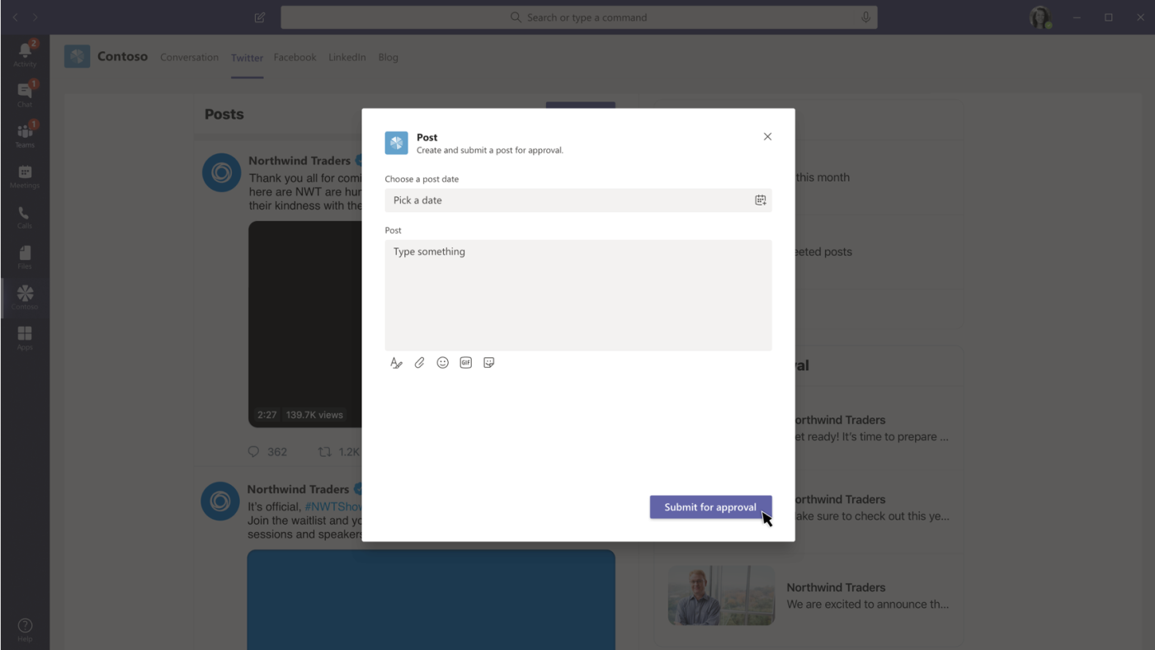
Action-based messaging extensions
Action commands allow developers to present users with a modal popup to collect or display information.
Define action-based messaging extensions.
Create and send the task module
Respond to the submit action.

Slide 25
Demo
Understanding messaging extensions in Microsoft Teams
Notes:
Demo Resources Found Here: https://microsoft.sharepoint.com/:w:/t/MOCtoBaselineevents/EbSyzOo8NcNAoNsgw5n4VH0BSonSRR2CcogDOcbwNJ7mlw?e=l6EeHS

Slide 26
Conversational bots in Microsoft Teams

Slide 27
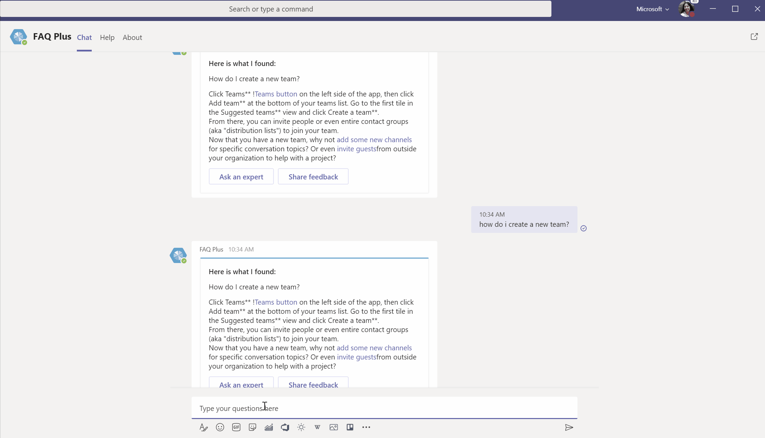
Overview of Bots in Teams
Bots are apps that users interact with in a conversational way.
Users can enter text or graphics or use speech.
Every interaction between a user and a bot generates an activity object.
The Bot Framework Service sends the activity objects between the user's channel and the bot.
Notes:
Conversational bots allow developers to provide chat capabilities to users, and developers can create several types of chats, such as group chats with more than two people, or chats between a single user and a bot.

Slide 28
Overview of Bots in Teams
Conversational bots in Teams apps allow users to interact with the web service through text, interactive cards, and task modules.
Types of conversations:
In a channel.
In a group chat.
In a one-on-one chat.
Teams App Bot Scenarios.

Slide 29
Bots Conversation Basics
Basic conversation is handled through the Bot Framework Connector, a single REST API to enable the bot to communicate with Teams and other channels.
Message content.
Receiving messages.
Sending messages.

Slide 30
Teams plus Power Platform

Slide 31
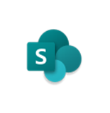

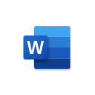
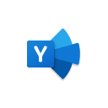
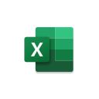
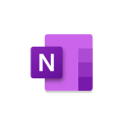








Power Platform can accelerate development of custom tools for Teams
Focus of today’s discussion
Microsoft Teams as a Platform
Ready-made apps
Low-code apps & workflows
(Power Platform)
Technical effort required
High-code
custom solutions
Departmental tools
Employee resources
Processes and workflow
Support and info

Slide 32
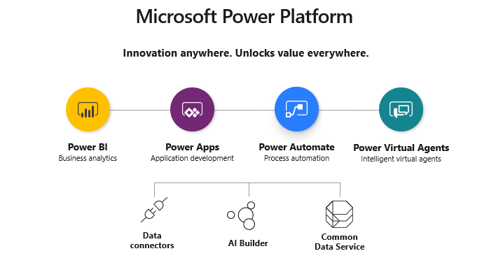
Introduction to Power Platform
Notes:
Microsoft’s Power Platform consists of four key products that enable users to create solutions that can accelerate their business:
Power Apps
Power Automate
Power BI
Power Virtual Agents
This lesson provides an overview of the Power Platform products so that you can see how they work together.
Each product will be covered in detail in the upcoming lessons.

Slide 33
Power Apps overview

Slide 34

Introduction to Power Apps
Microsoft PowerApps is a service that lets you build business apps that run in a browser or on a phone or tablet, and no coding experience is required.
There are three types of PowerApps:
Canvas apps
Model-driven apps
Portals
In this lesson, we will explore creating Canvas Apps

Slide 35
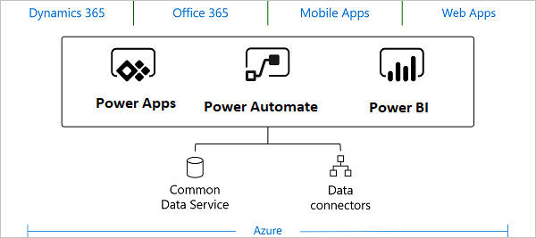
Connecting Power Apps to Data
Connectors act as a bridge from the data source to the Power App (or workflow in Power Automate), thereby allowing information to be transported back and forth.
Power Apps supports over 275 connectors for popular services and on-premises data sources, including SharePoint, SQL Server, Office 365, Salesforce, and Twitter.
Connections to on-premises data sources, such as an on-premises SharePoint service, require the use of an on-premises data gateway.
When an app or workflow creates a connection to a data source, the connector typically requires some form of authentication.
The Common Data Service is a type of data source that lets you securely store and manage data that is used by business applications.

Slide 36
Creating a Canvas Power App
There are three ways to start creating a canvas Power App:
Start from blank
Start from a template
Start from data
When starting with a blank canvas, the app creator can add data sources to the app by connecting to data sources using connectors (for example, using the SharePoint connector) or by selecting the desired CDS entities.
Controls are the user interface elements of the application, whose properties can be configured for appearance and behavior. The app creator builds the canvas app by adding controls. Controls may be associated with data sources.
Saving changes to a canvas app automatically publishes them only for the app creator and anyone else who has permissions to edit the app.
When an app creator finishes making changes, he or she must explicitly publish the changes to make them available to everyone with whom the app is shared.
Once the app is published, the app creator can specify which users in the organization can run the app and which users can modify and even reshare the app.
Notes:
Demonstrate how to start an app and show them the three panes in Power Apps Studio.

Slide 37
Running a Power App
The process of running a Power App varies depending on the app type.
Canvas apps can be run on mobile devices, SharePoint Online, and Microsoft Teams.
App creators that are part of Microsoft Partner Network can share a canvas app with customers to generate leads for their business by using AppSource.com and Power Apps Test Drive solutions.
Model-driven apps run on a mobile device using the Dynamics 365 mobile app (the Power Apps mobile app cannot be used to run a model-driven app).
If a user does not have the Dynamics 365 app for phones and tablets installed, the app can be run on a web browser on a tablet, as long as the device has a sufficiently high screen resolution.
Notes:
Demonstrate how to start an app and show them the three panes in Power Apps Studio.

Slide 38
Demo
Create a Power App from a SharePoint data source
Notes:
Prerequisite: Create a SharePoint Online list
Task 1: Review the Service Desk Request List
Task 2: Create a Power App
Task 3: Review the Power App Studio (optional)
Task 4: Customize the App (optional)
Task 5: Add the Ticketing System app to Microsoft Teams
Task 6: Run the app from a mobile device (optional)
Alternatively, show the click-through demo for Teams and Power Platform demo, shows Power App in Teams, but not how to build the app.

Slide 39
Power Automate overview

Slide 40

Introduction to Power Automate
Microsoft Power Automate is an online workflow service that enables an organization to work smarter and more efficiently by automating workflows across its most common apps and services. Workflow examples include:
Instantly respond to high-priority notifications or emails
Capture, track, and follow up with new sales leads
Copy files from one service to another
Collect data about your business and share that information with your team
Automate approval workflows
You can create the following types of flows in Power Automate:
Automated flows
Instant flows
Scheduled flows
Business process flows
UI flows
Notes:
Mention that Power Automate was formerly known as Microsoft Flow. Some students may have been familiar with Flow and are wondering how it relates to Power Automate.
Power Automate provides a low-code platform for building workflow and process automation.
In this lesson, you will learn how to use Power Automate to build a workflow that meets your business needs and interacts with your business data.
You will also learn how to administer Power Automate.

Slide 41
Connecting Flows to Data
Power Automate is similar to Power Apps in that it uses connectors to act as a bridge from the data source to the workflow.
Connectors can either be public or custom.
Connectors make triggers and actions available that can be used by flows.
Triggers are used by flows to start the execution of the workflow.
Actions are used by flows to perform a defined set of actions during execution.
Some of the triggers that are more commonly used in flows include:
When an item is created
When an item is created or modified
When an item is deleted
Some of the actions that are more commonly used in flows include:
Add an attachment
Copy a file
Check in a file
Check out a file

Slide 42
Creating a Flow
There are three ways to start creating a flow:
Start from blank
Start from a template
Start from a connector
The Power Automate Designer is a feature-rich tool that enables users to configure every detail of flow logic.
The following elements are used when creating a flow:
Triggers
Actions
Dynamic content
Peek code
Functions
Advanced functionality
The Flow Checker checks for any errors or warnings in your flow and calls out the actions where the errors or warnings occur.

Slide 43
Running a Flow
Once a flow is saved without errors, it is active and available to run when the trigger condition is satisfied.
Button (instant) flows run when manually triggered.
Flows can be scheduled to run when a trigger condition occurs, or they can be run immediately by pressing the Run button.
Flows can be shared with other users as co-owners or run-only users.
When a user adds another user or group as an owner of a flow, that flow becomes a team flow (which only show up under Team flows). Co-owners of the flow can also modify the flow using the connections that already exist.
Run-only sharing is an option when the flow is manually triggered (button flows). The user with whom the flow is shared can only run it; the user cannot edit the flow.
Flows can be run from the following sources:
A flow can be executed from within SharePoint when a flow containing a SharePoint List is shared.
Users can create, manage, and run flows from within Microsoft Teams.
Power Automate flows can be created, managed, and run from the Power Automate mobile phone app.

Slide 44
Demo
Create a flow using Power Automate
Create a Power Automate Flow
Assign an additional owner to the Power Automate Flow (optional)
Notes:
Alternatively, show the click-through demo for Teams and Power Platform demo, shows approval notification, from a Power Automate flow, arriving in Teams, but not how to build the flow.

